Slide 1
DNA Methylation Pipeline
Analysis of DNA methylation in blood monocytes of severe COVID-19 patients
By: Group 3

Slide 2
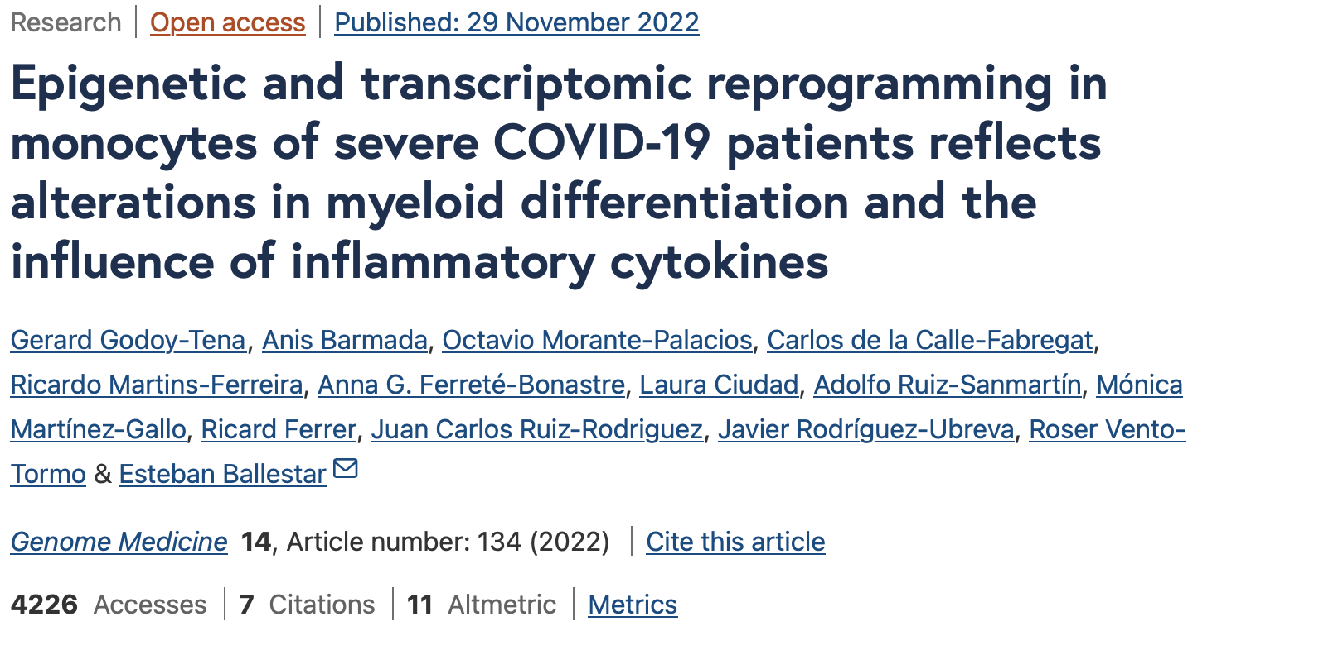

Slide 3
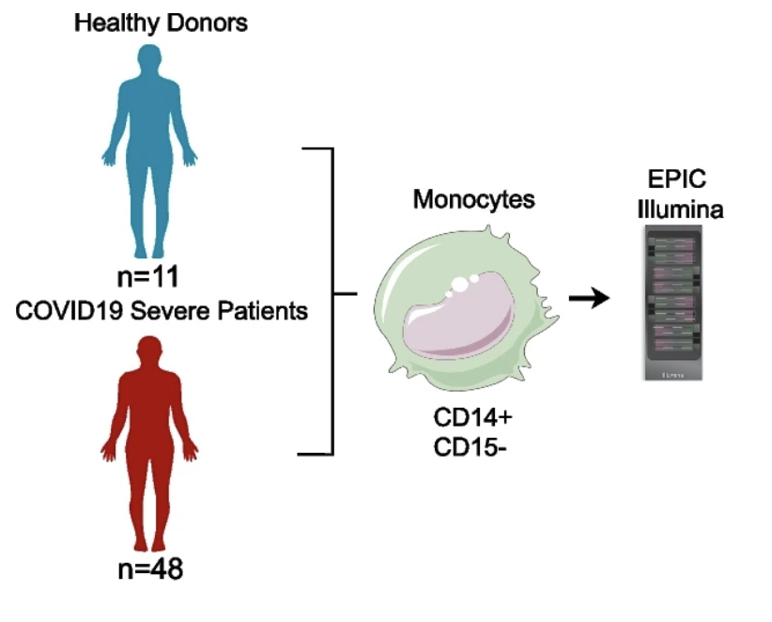
Experimental Design

Slide 4
DNA Methylation Pipeline
shinyEPICo
Noob
limma
iEVORA
1. QC
2. Filtering
3.Normalization
4. DMP
5. DVPs
Goal: Test the quality of the bisulfite conversion
Quality threshold > 2:
Red/green ratio calculation
Goal: Removing features, which introduce some bias
1. CpH and SNPs loci
Goal: Correcting
Quantile Normalization
+ remove sex chr
+ batch correction
Goal: Identify sites differentially methylated between healthy and COVID
eBayes moderated t-test
FDR < 0.05
Δβ of > 0.15
Goal: Identify differentially variable positions
Bartlett’s test (FDR < 0.001) → t-test (p < 0.05)

Slide 5

DNA Methylation Pipeline
Enrichr
GREAT
HOMER
chromHMM
6. Correlation Analysis
7. PCA
8.Gene Ontology Analysis & Enrichment
9. Motif Enrichment
10. Chromatin state enrichment
Goal: Identify CpG sites correlated with SOFA scores.
Spearman’s correlation coefficient (rho):
CpG sites with rho > 0.4
p-value < 0.01
Goal: Correlate PCs (of b-values) with clinical variables
Goal: Annotate Genomic Regions + find DEGs
GRCh37 (UCSC hg19)
a > 2 fold change
FDR < 0.05
Enrichment = log2(FDR)
Goal: Transcription Factor Binding Sites
findMotifsGenome.pl
± 250 bp window
Fisher’s exact test
Goal: Functional state of chromatin
Roadmap Epigenomics Project
Fisher’s exact test
Background: EPIC array

